Slide 1
3D Functional Clock Project in Autodesk Maya
Created and Automated by [PRITHWISH GHOSH]
Roll no: 24IT3038

Slide 2
Project Overview
Objective | Develop a fully functional 3D clock model using Autodesk Maya
Used and alternative resources | Autodesk Maya, Python
Implementations | Real time motion for hour, minute, second hands using python scripting
integrations | Arnold renderer with realistic materials, lighting and reflecvtions
Rendering process | Optimised performance by enabling GPU rendering.

Slide 3
Table of contents
01
02
03
Purpose
Hypotheses
Objectives
04
05
06
Methodology
Analysis
Conclusions
To create fully functional 3D analog clock in Autodesk Maya
Procedure and working of clock
Fetch real time from system and display it perfectly
3D modeling and backend coding
Rotation behavior analyzed through angle calculations for each hand
Successfully built a real-time functional 3D clock system inside Maya.

Slide 4
Purpose
01

Slide 5
The purpose of the project is to design and implement a fully functional 3D analog clock inside Autodesk Maya that operates exactly like a real-world clock. This includes accurately rotating clock hands based on real time, achieving clean and precise modeling, and enhancing the final output using advanced rendering features of Arnold. Additionally, the project demonstrates how Python scripting can automate and control complex animations inside Maya.

Slide 6
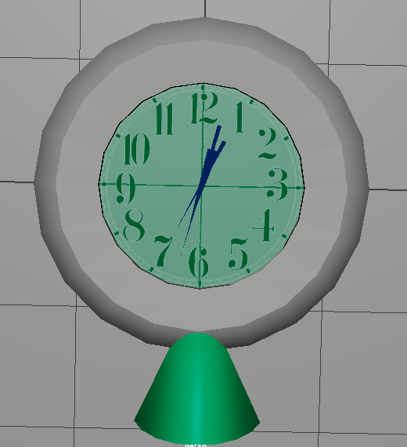

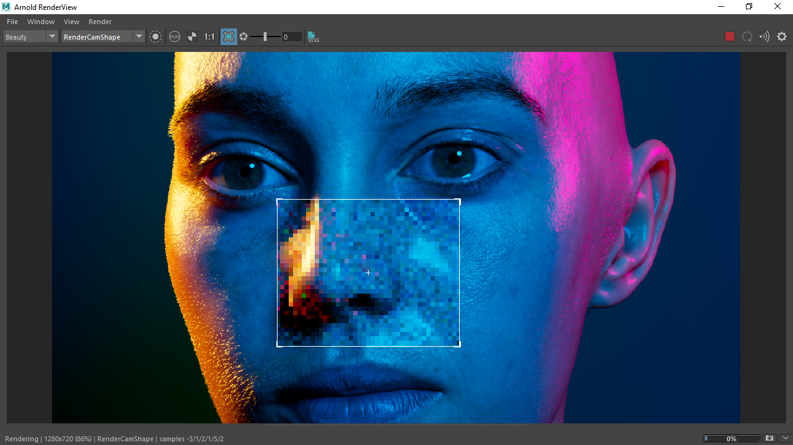
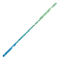
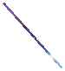
Purpose Visualization
3D clock model
Python Scripting
Arnold Rendering

Slide 7
Hypotheses
Time Synchronization Hypothesis
Mechanical Accuracy Hypothesis
Material Realism Hypothesis
It is possible to synchronize Maya animations with real system time using Python’s “datetime” module.
If pivot placement is precise, each hand will rotate correctly:
30° per hour
6° per minute
6° per second
Using Arnold’s physically-based shaders will produce realistic glass, metal, and reflections. Using Arnold GPU can improve rendering speed for interactive updates.

Slide 8
Study objectives
Accurate Modeling
Shading Realism
Build all clock components with precise measurements.
Apply metal, glass, and face materials using aiStandardSurface.
Functional Autamation
Lighting
Use Python to automate rotation based on actual time.
Set up Arnold lighting that enhances reflections.

Slide 9
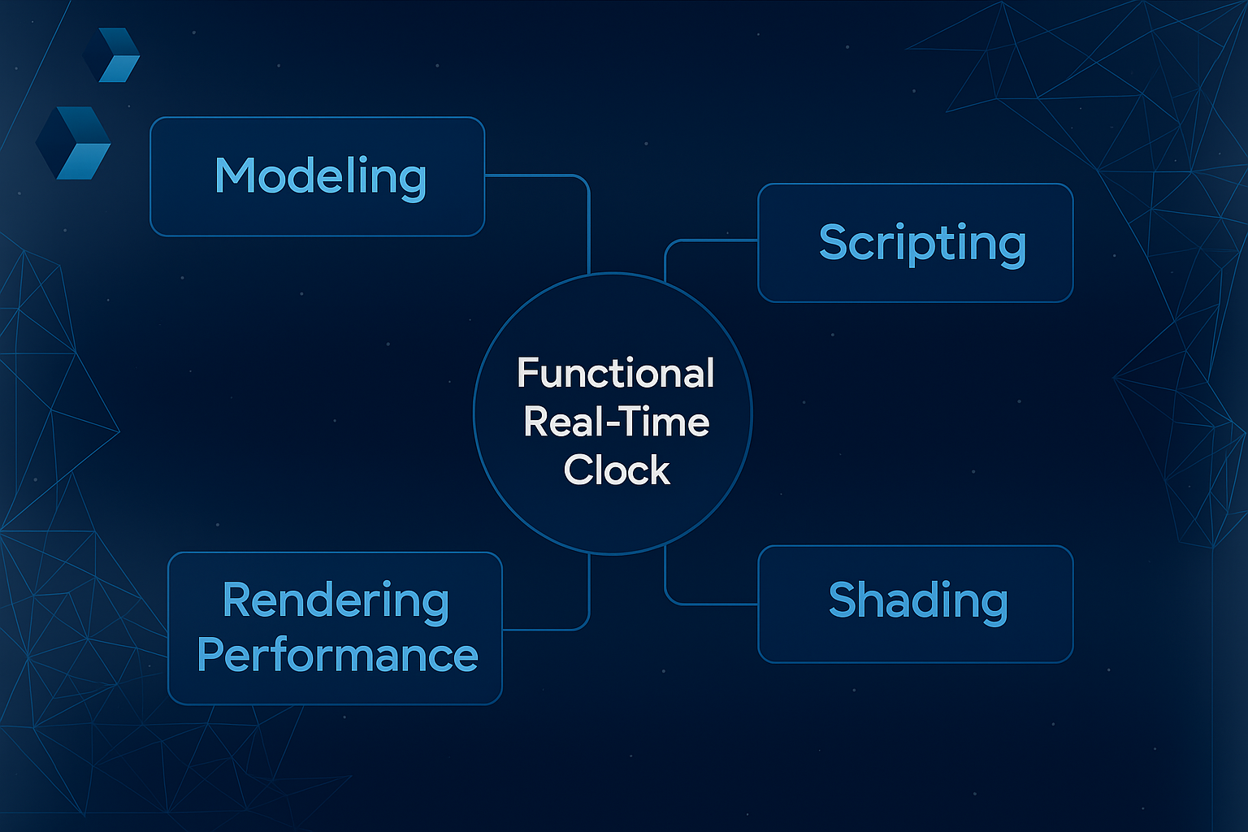

Slide 10
Methodology
Modeling Phase
Create clock body face hands and glass cover. Used duplicate special for accuracy. Ensured all pivots were centered
Python Automation
Used “datetime” to read real time. Applied “setAttr()” to rotate hands dynamically. Implemented threading for continous updates.
Shading & Lighting
Assigned plastic shaders to hands glossy shader to face transparent shader for glass. Added skydome for illumination
Rendering
Enabeled Arnold GPU mode for fast IPR rendering.

Slide 11
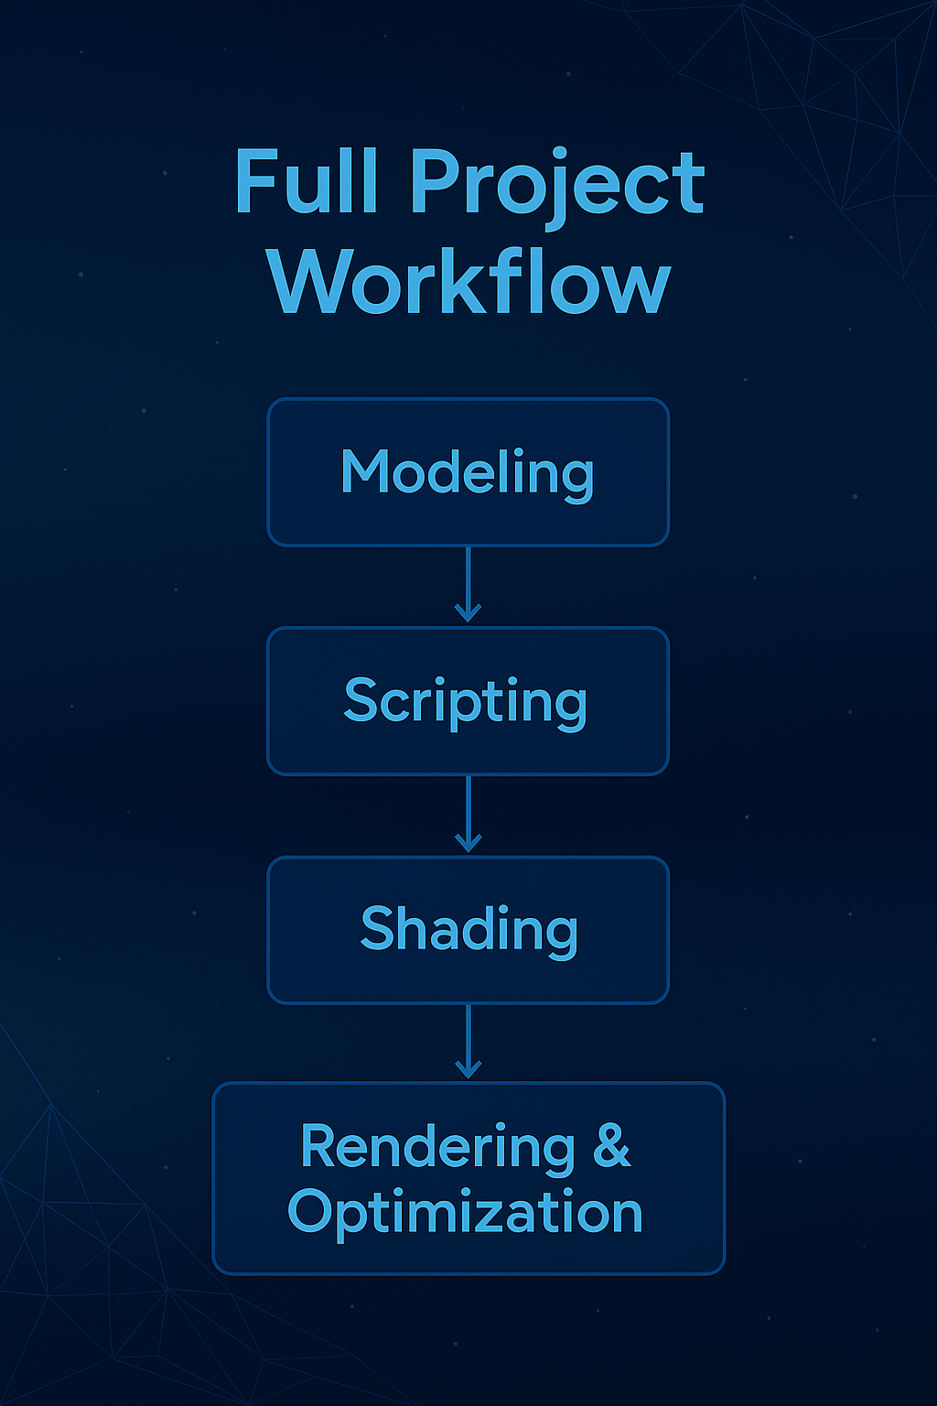

Slide 12
Analysis & development
Rotatioin Behaviour
Pivot and Axis issue
The second hand moves at 6* per second. The minute hand smoothly rotates at 6* per minute + small motion every sec. The hour hand precisely rotates 0.5* per sec.
Misalignment caused incorrect angles. Freez transform + manual rotation is corrected
Script Stability
Rendering Behaviour
Glass required higher ray depth to avoid dark or missing areas. Skydome lighting improved reflections significantly
The use of threading kept Maya responsive. evalDeferred() prevented UI blocking

Slide 13
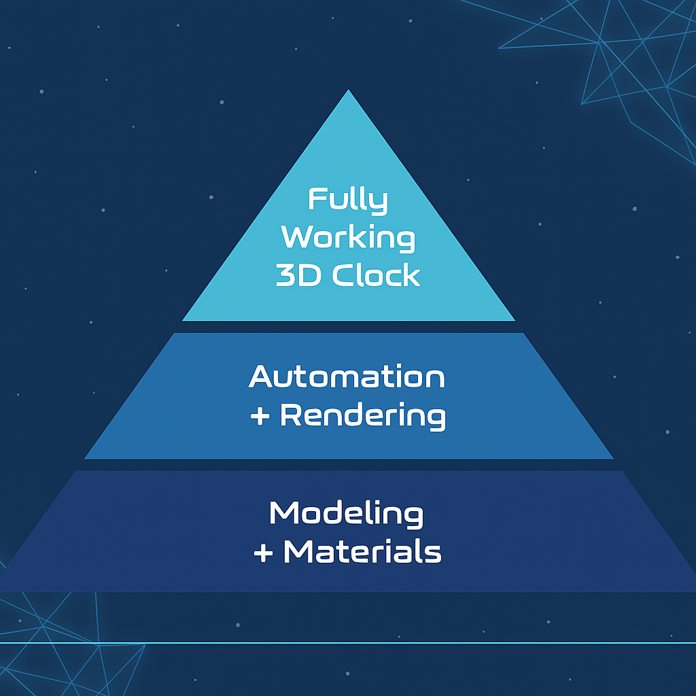
Conclusions
Working Pyramid
A successful integration of modeling, scripting, and rendering in Maya.
Python scripts can control complex animations in real time.
Arnold shaders enhance realism with physically accurate lighting and materials.
GPU rendering dramatically speeds up visualization.
The functionality is extendable with UI controls, presets, and analytics.

Slide 14
Sources and Links
01
AutoDesk
03
GFG
Working software
Source codes for background scripts
Github
02
Wikipedia
04
Project links:
https://github.com/KricxHack2005/3D-clock-in-Maya.git
Research data and analysis

Slide 15
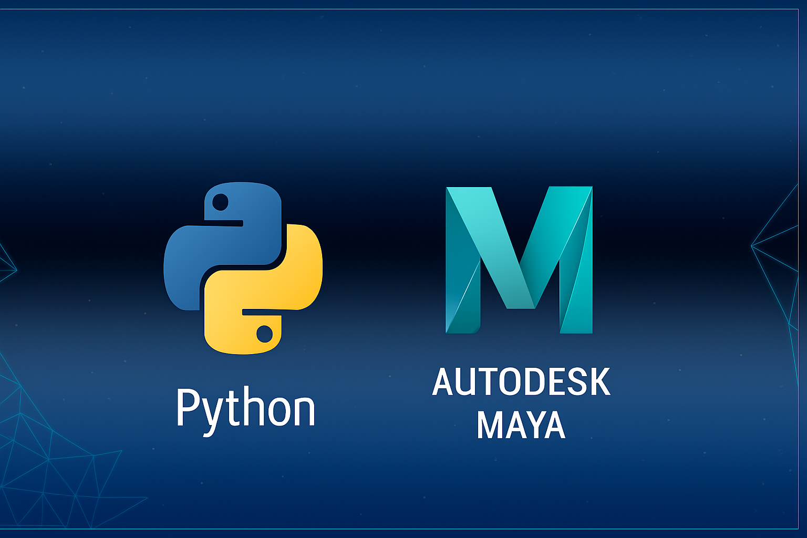
Technology references
Maya Python API
Arnold Renderer
GPU Rendering
Why these technologies were essential:
Maya gave full control over modeling and animation.
Python made the clock functional and time-accurate.
Arnold ensured high-quality visuals.
GPU allowed smooth real-time IPR previews.

Slide 16
Thanks!
Do you have any questions?
24IT3038@rgipt.ac.in

